Slide 1
Medical Assistance in Dying on Vancouver Island
-the first year
Dr. Stefanie Green
Dr. David Robertson

Slide 2
DR. STEFANIE GREEN
Previous life:
Family physician
Maternity doctor
Current Life:
MAiD provider+
Relevant associations:
University of British Columbia/University of Victoria (clinical faculty)
Co-founder, Director and President Canadian Association of MAiD Assessors and Providers (CAMAP) www.CamapCanada.ca

Slide 3
DR. DAVID ROBERTSON
Previous life:
Anesthesthiologist
Current Life:
Executive Medical Director
VIHA Executive Lead on MAiD
Relevant associations:
University of British Columbia/University of Victoria (clinical faculty)

Slide 4
Sources of Data
Case Review- All records from each MAiD death on Vancouver Island have been submitted to the Vancouver Island Health Authority (VIHA) working group on MAiD for review. All information is entered into the Island Health RedCap database. We analyzed the data for demographics, trends, and also for signs of gaps in data collection and service availability.
Interim update on Medical Assistance in Dying in Canada, June 17-December 21, 2016 https://www.canada.ca/en/health-canada/services/publications/health-system-services/medical-assistance-dying-interim-report-dec-2016.html
BC Coroner’s Report
Calculations by Dr. J. Reggler/Dr S. Green based on provincial populations and annual death rates (Statistics Canada)
CAMAP members across the country

Slide 5
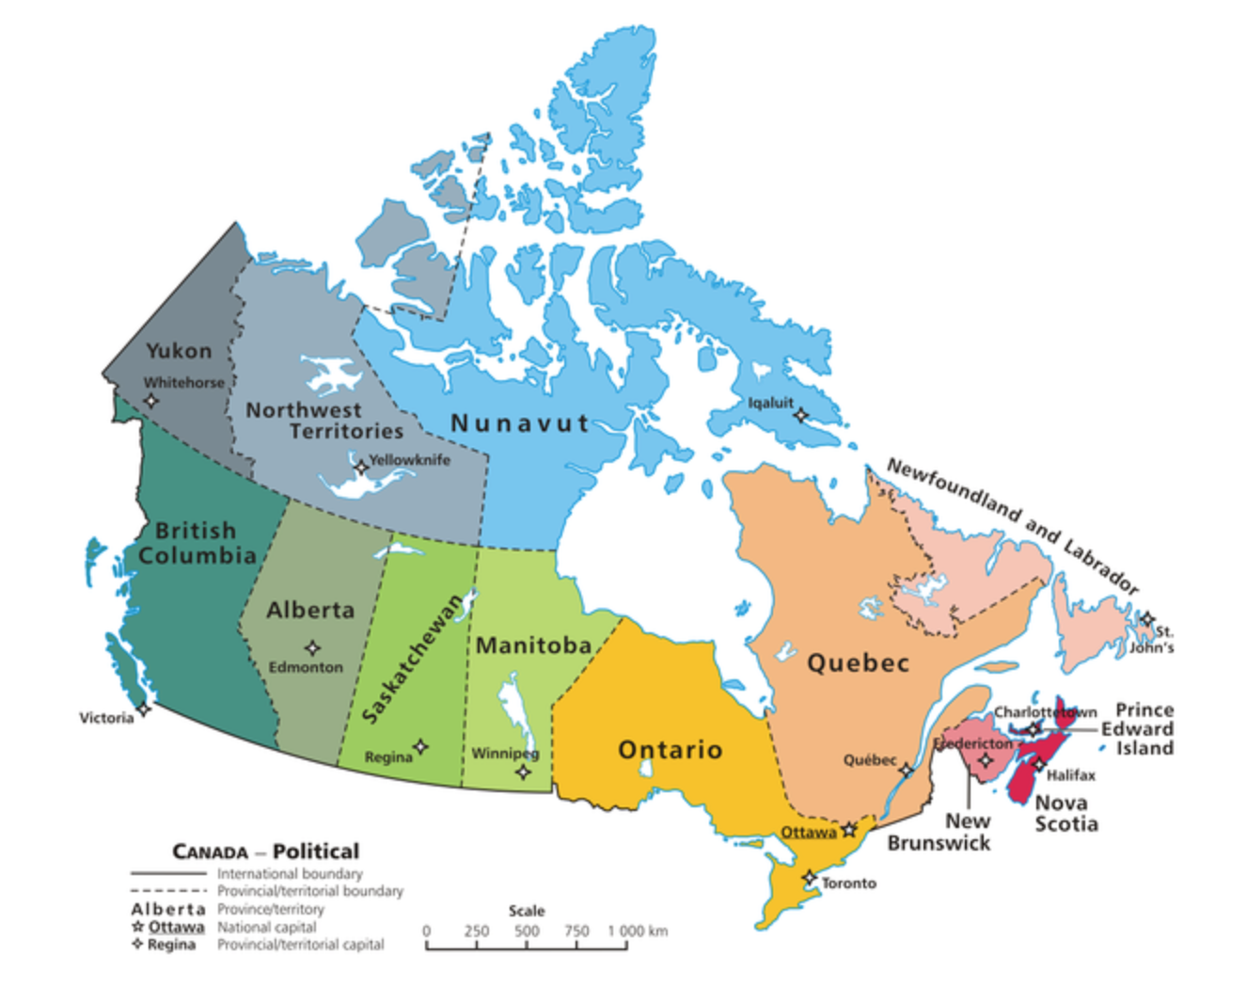

Slide 6
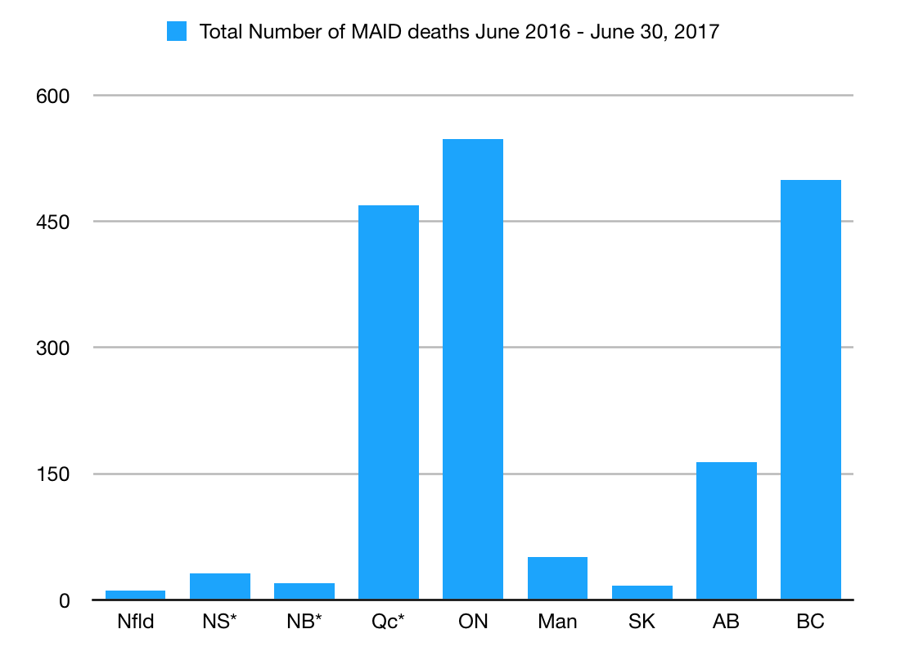

Slide 7
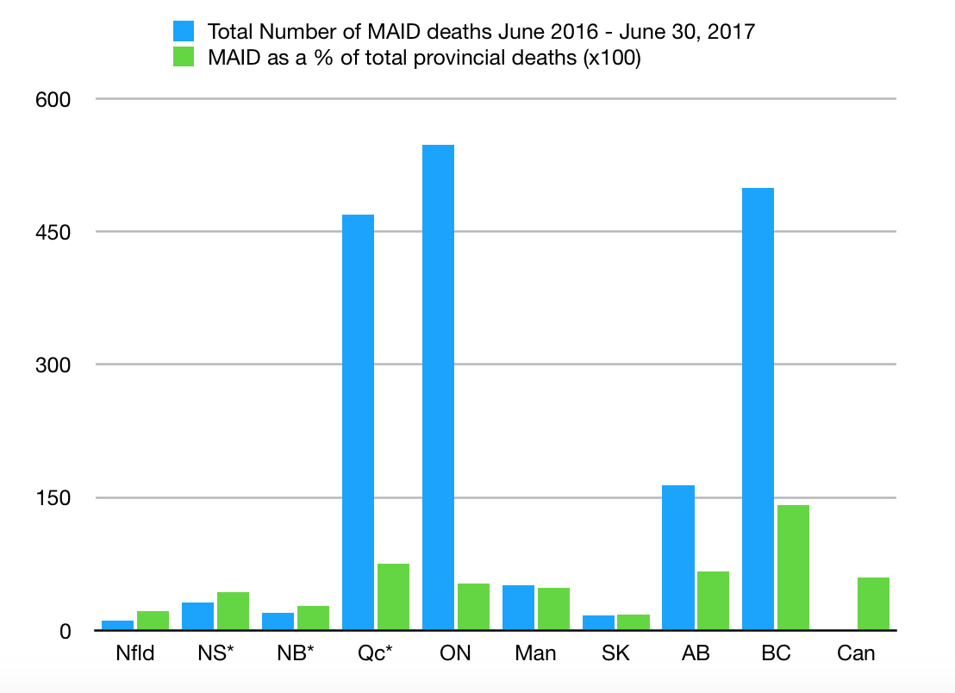

Slide 8
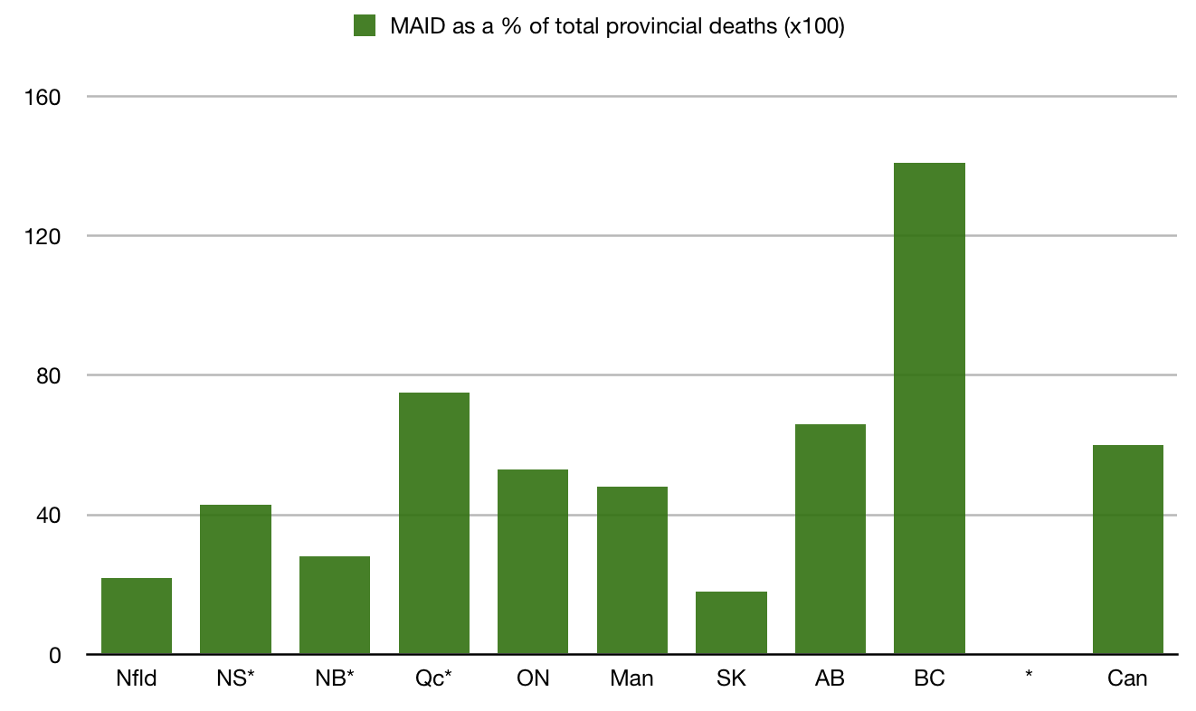

Slide 9
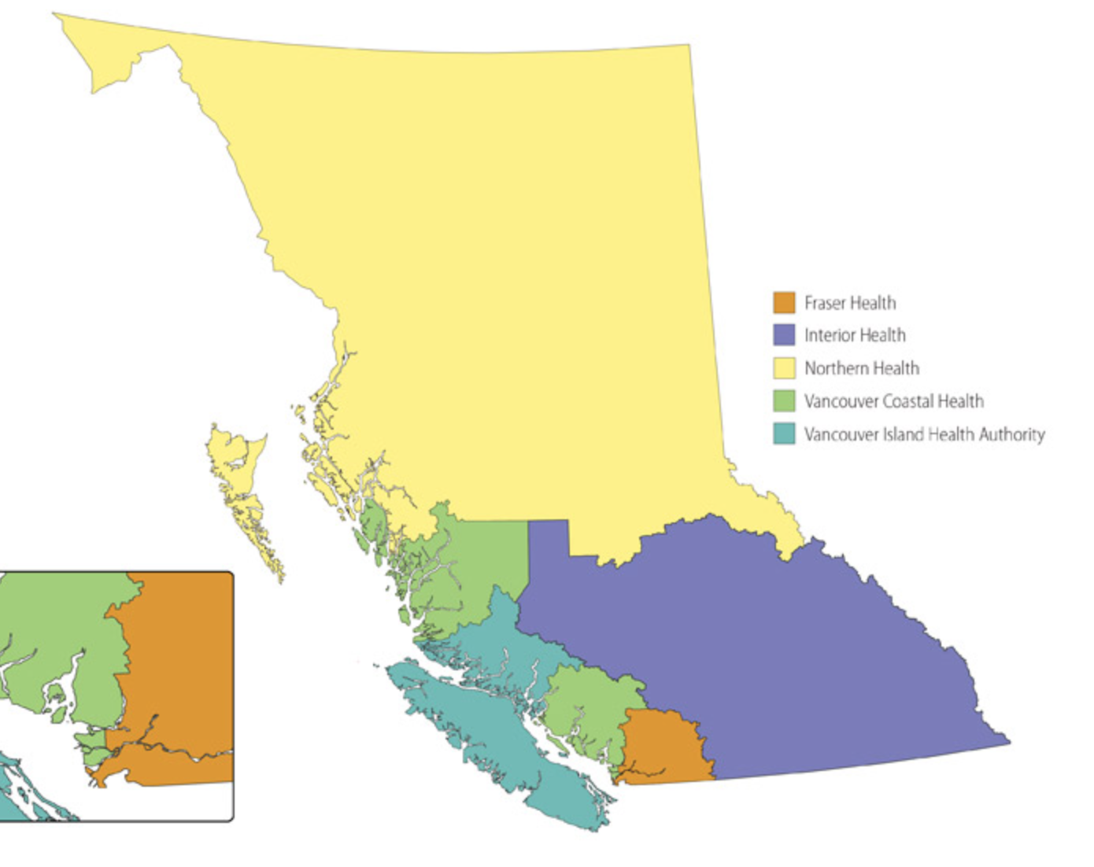

Slide 10
BC Data
January 1, 2016 - June 30, 2017
Fraser Health 64
Interior Health 78
Island Health 210
Northern Health 15
Vancouver Coastal 132
Total MAID Deaths 499 (approx 1.4% of all deaths)
*Eight of these deaths were reported prior to June 17, 2016.

Slide 11
Vancouver Island
As of June 30, 2017 there have been 210 MAID deaths
This is approximately 3% of all deaths
THIS IS THE HIGHEST NUMBER OF MAID DEATHS, PER CAPITA, IN THE COUNTRY

Slide 12
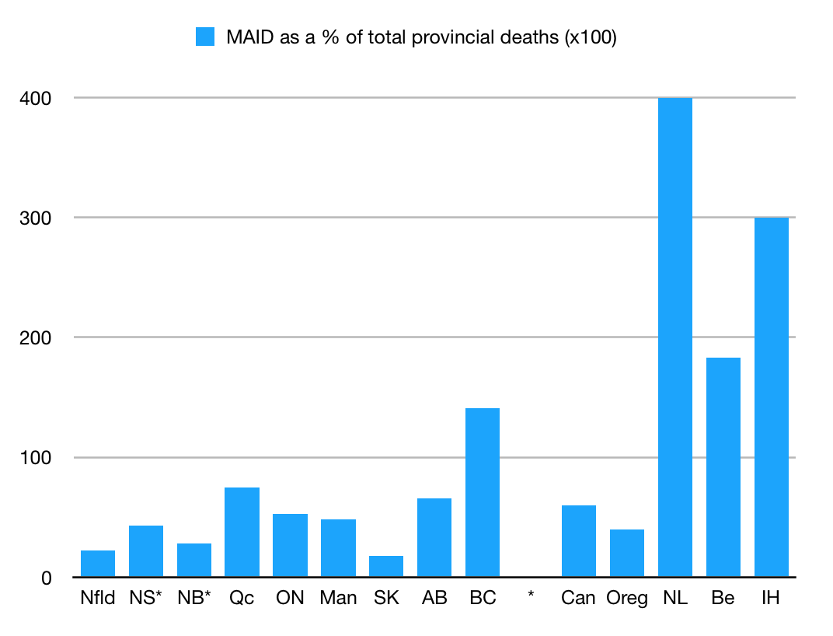

Slide 13
Vancouver Island MAiD
-the first year

Slide 14
MAID Deaths per Month

Slide 15
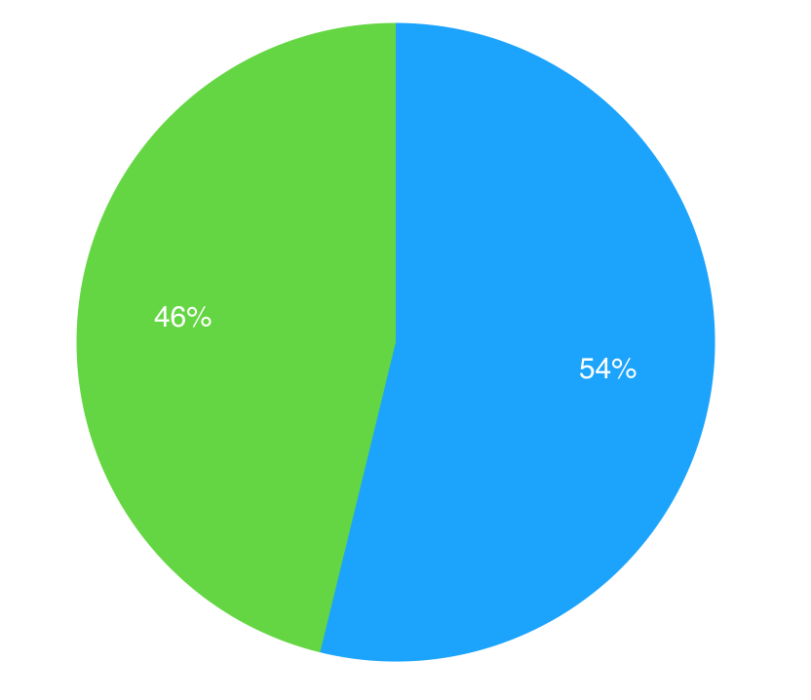
Gender
Slightly more males than females

Slide 16
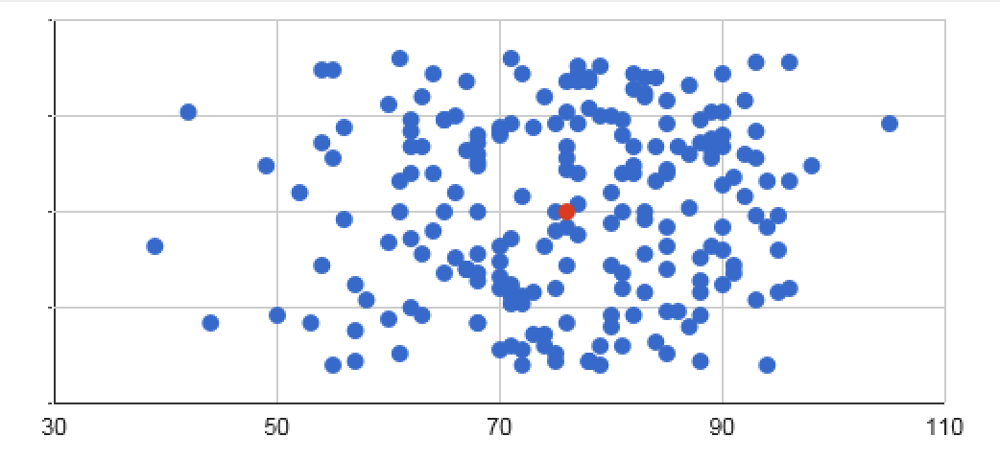
Age
Average age was 76 years ranging from 39 to 105

Slide 17
14% of all cases employed telehealth services during assessment

Slide 18
Days from Request to MAID

Slide 19
25% of all cases were expedited to less than 10 days

Slide 20
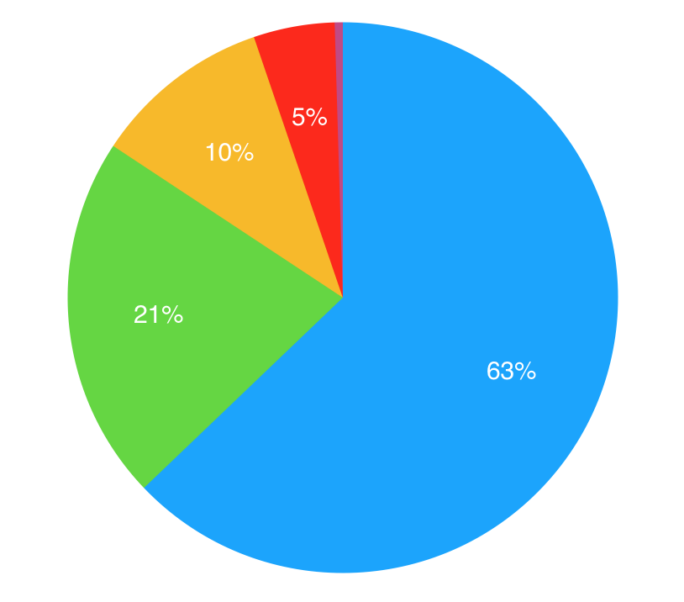
Underlying diagnosis
Cancer
Organ Failure
Neuromuscular
Frailty

Slide 21
% MAID at Home

Slide 22
Location of MAID

Slide 23
Note hospice numbers (14%)

Slide 24
Prescribers and Assessors Cumulative total

Slide 25
With the data we have it is not (yet) possible for us to reliably report on:
the number of patients who made initial inquiries
the number who made formal requests and did not meet criteria
the number who died before MAID or who otherwise decided not to go ahead with MAID

Slide 26
Conclusions
1. MAiD deaths on Vancouver Island account for 3% of all deaths. Median age is 76, vast majority are by iv route and gender equality is apparent. As expected, most common underlying illness is malignancy. Out of ordinary for Canada, on VI most are in home.
2. Access to MAiD is restricted by the geographic proximity of prescribers. The ongoing struggle to increase the number of prescribers is a real obstacle to access to MAID. There may be several factor involved (legal fears, financial disincentives, admin load, ?emotional toll). Faith-based institutions have declined to allow MAiD on the premises necessitating patient transfers but hospice in Victoria is allowing MAiD on the premises for those already admitted.
3. With the data we have it is not possible for us to reliably report on the number of patients who made initial inquiries, the number who made formal requests and did not meet criteria, and the number who died before MAiD or who otherwise decided not to go ahead with MAiD.

